Slide 1
Handwritten digit recognition using SVD
GROUP 1
REVANTH S – CB.AI.U4AID25043
G KAMALESH - CB.AI.U4AID25014
JASWANTH S - CB.AI.U4AID25047
ELANGO MEGABALA G - CB.AI.U4AID25013

Slide 2
Introduction:
Handwritten digit recognition using singular value decomposition (SVD) is a machine learning technique that identifies digits (0–9) from image datasets like MNIST.
The motivation behind using SVD for handwritten digit recognition is to reduce data complexity while keeping important features, making the recognition process faster, efficient, and accurate.

Slide 3
Problem statement:
The problem is to develop a system that can accurately recognize handwritten digits from image data using singular value decomposition (SVD) for feature extraction and dimensionality reduction, ensuring fast and reliable classification of digits (0–9).

Slide 4
objective:
Primary objective: To design an efficient, interpretable, and computationally simple model for recognizing handwritten digits using SVD.
Specific goals:
Extract key features from digit images using SVD.
Reduce dimensionality without losing critical visual information.
Use singular value vectors as input to a simple classifier (Eg: Nearest neighbour).
Evaluate recognition accuracy.

Slide 5
LITERATURE REVIEW:
Previous work:
Neural network and CNN-based models (Eg: Lenet, alexnet) dominate current state-of-the-art but require large training datasets.
SVD, as discussed in works by eldén and savas (2003), decomposes image matrices into orthogonal bases, capturing the most essential structure of handwritten digits.
Limitations:
There is limited use of classical matrix decomposition approaches in low-resource handwriting recognition.
SVD provides interpretability and mathematical simplicity with resilience against noise and redundancy.

Slide 6
Methodology:
Workflow overview:
Data collection: use MNIST.
Preprocessing: normalize images, convert grayscale (0–255) to float (0–1).
Compute SVD for each image matrix m, perform
M=UΣV^{T}
Where U and V are orthogonal matrices and Σ is the diagonal matrix of singular values.
Feature selection: retain top-k singular values per image to form a compact representation.

Slide 7
Methodology:
Classification: compute Euclidean distance between singular vectors to match with closest training digit.
Performance evaluation: measure accuracy, confusion matrix, and visualize reconstructed digits from singular values.
Flow of process: dataset → pre-processing → SVD feature extraction → classification → prediction
Tools used:
i.MATLAB
ii.Dataset used: MNIST

Slide 8
Methodology OVERVIEW:
Data collection: utilize the MNIST dataset for model training.
Preprocessing: normalize images and convert to matrix format.
SVD implementation: decompose matrices to identify key features.
Classifier design: use k-nn for digit classification.
Model evaluation: perform cross-validation and calculate accuracy.

Slide 9
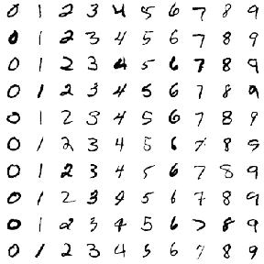
Sample from MNIST

Slide 10
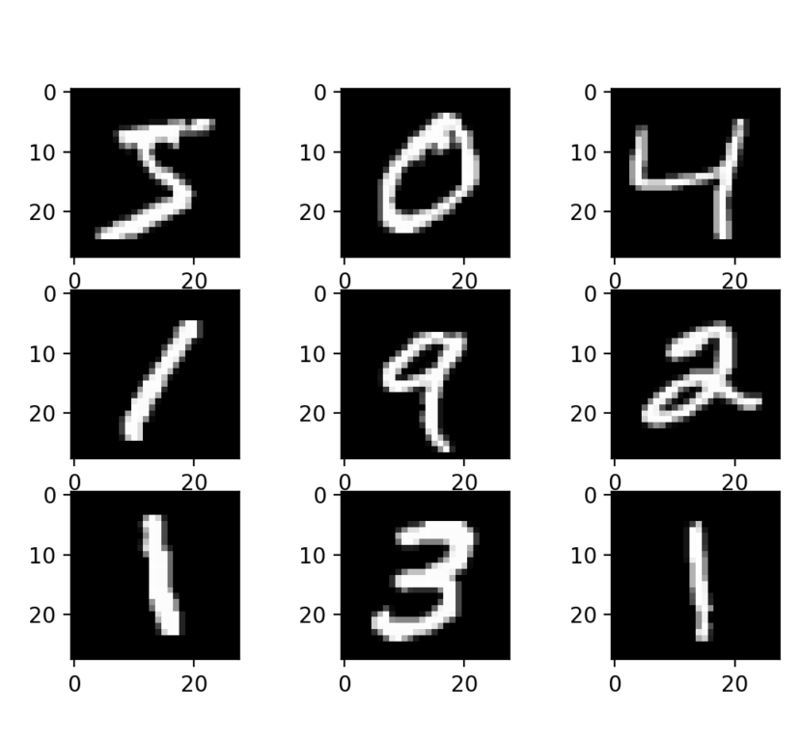
Sample input in MATLAB

Slide 11
Source Code

Slide 12
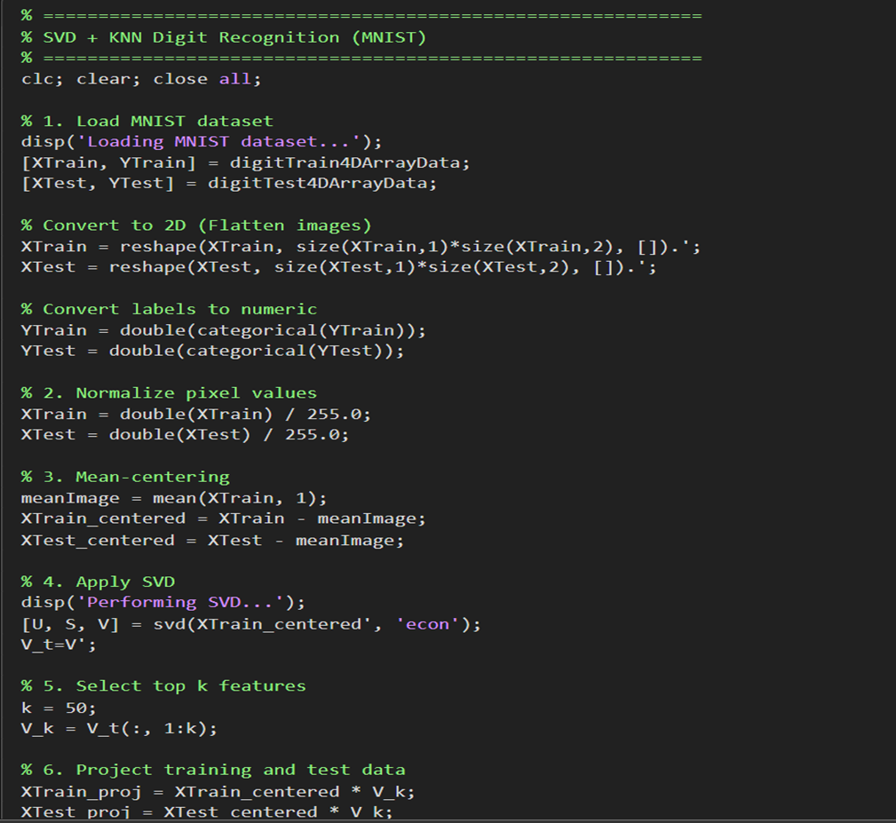

Slide 13
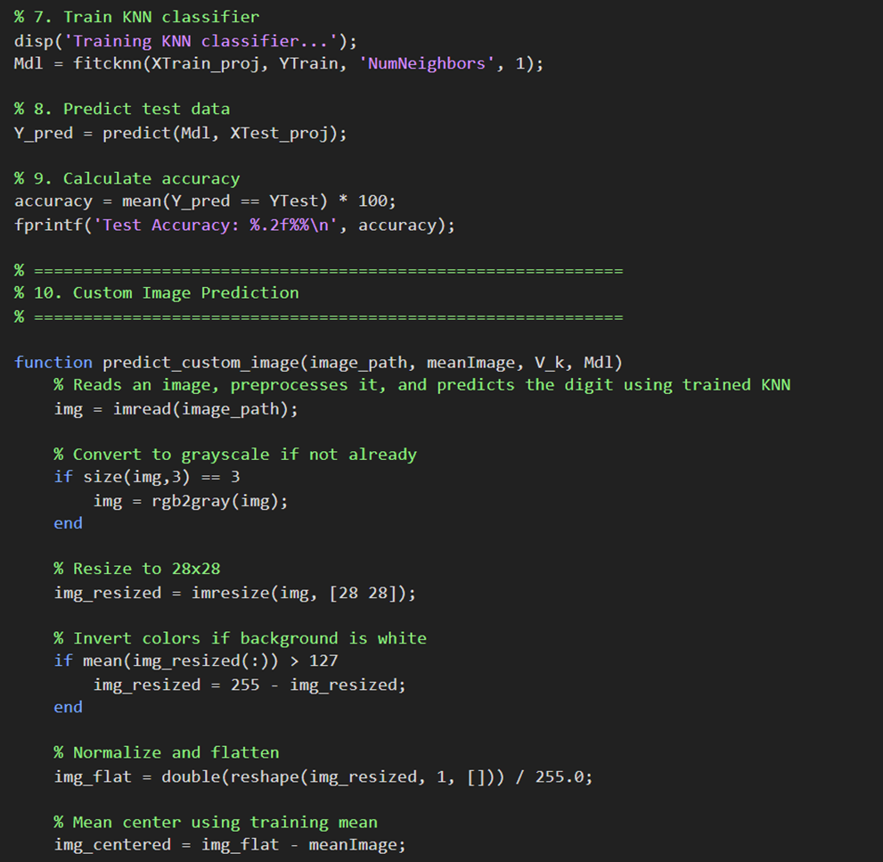

Slide 14
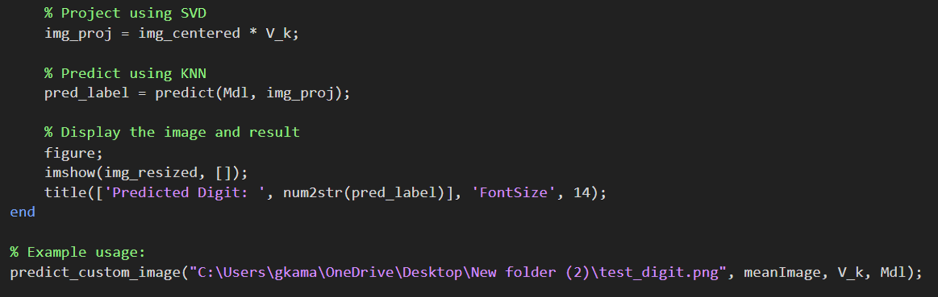

Slide 15
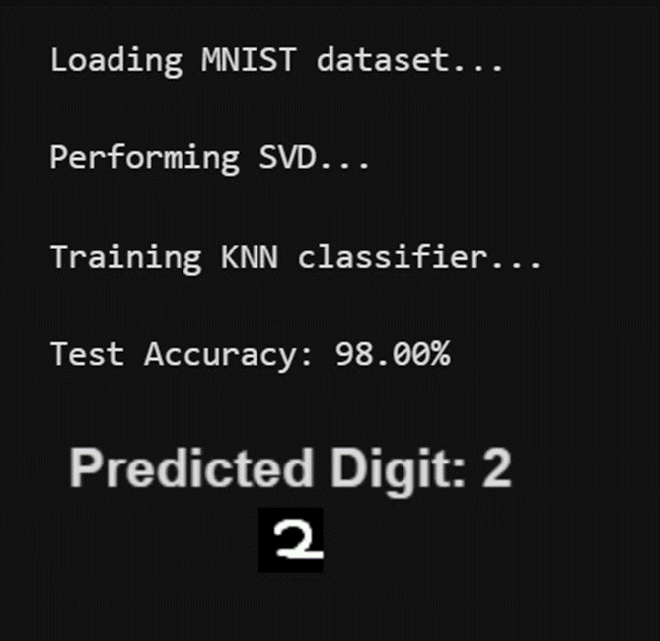
Output

Slide 16
Algorithm Steps:
Load and visualize digit dataset.
For each image, apply SVD decomposition.
Choose the top k singular values as the signature.
For a new test image, compute SVD and compare its signature to all training digits using Euclidean distance.
Predict the label with minimum distance.

Slide 17
Observations:
Retaining top 50 singular values achieves accuracy around 93–97% using nearest neighbor.
Using top 50 singular values improves accuracy but with slightly reduced efficiency.
Visualization shows reconstructed digits are visually clear with only a few singular values retained.

Slide 18
Conclusion:
SVD-based recognition is a promising approach balancing accuracy and computational efficiency.
Current progress shows the system is functional with good preliminary results.

Slide 19
References:
Eldén, L. (2007). Classification of handwritten digits - UC Davis.
Introduction To MATLAB For Engineering Students - David Houcque
Sciencedirect.Com - handwritten digit classification using SVD.

Slide 20
Thank You

